Slide 1
Simulation of Computer Systems
Unit 8

Slide 2
Outline
Simulation Tools,
Simulation Languages: GPSS,
Case Studies of different types of Simulation Models

Slide 3
Simulation Tools
Simulation software is based on the process of modeling a real phenomenon with a set of mathematical formulas.
Simulation tool allows the user to observe an operation through simulation without actually performing that operation.
A simulation language is a special purpose language structured to meet the programming requirements of the simulation models of a specific class of situations.
The analyst develops the simulation model, employing this special purpose language, which is applicable over a class of applications.

Slide 4
Simulation Tools
Example of Simulation Tools :
GPSS – mostly applicable to queuing situations
SIMAN & SLAM II – appropriate for simulating the manufacturing and material handling system
AnyLogic - a multi-method simulation modeling tool for business and science
PTV Vissim - a microscopic and mesoscopic traffic flow simulation software.
SimPy - an open-source discrete-event simulation package based on Python.
OpenSim - an open-source software system for biomechanical modeling.
NetLogo - an open-source multi-agent simulation software.
Flood Modeller - hydraulic simulation software, used to model potential flooding risk for engineering purposes.
MATLAB - a programming, modeling and simulation tool developed by MathWorks.
VSim - a multiphysics simulation software tool designed to run computationally intensive electromagnetic, electrostatic, and plasma simulations.

Slide 5
Simulation Languages
The important features of simulation language can be identified as follows:
Generation of large streams of random numbers
Generation of random variates from a large number of probability distributions
Determining the length of simulation run and length of wrapping (covering) up period
Advancing the simulation clock
Scanning the event list to determine the next earliest event to occur
Collecting data
Analyzing data and setting confidence intervals

Slide 6
Simulation Languages
These common features, which have to be invariably (in every case) modeled in all simulations, are perhaps the cause of the development of special simulation software. Simulation software packages are designed to meet the following objectives:
To conveniently describe the elements, which commonly appear in simulation, such as the generation of random deviates.
Flexibility of changing the design configuration of the system so as to consider alternate configuration.
Internal timing and control mechanism, for book keeping of the vital information during the simulation run.
To obtain conveniently, the data and statistics on the behavior of the system.

Slide 7
Simulation Languages
Desirable Features of Simulation Software
Modelling Flexibility
Ease of Modelling
Fast Execution Speed
Compatibility of various Computer Systems
Statistical Capabilities
Capability of Animation
Report Presentation Capabilities

Slide 8
Simulation Languages
Merits of Simulation Language
Since most of the features to be programmed are in-built, simulation languages take comparatively less programming time and effort.
Since simulation language consists of blocks, specially constructed to simulate the common features, they provide a natural framework for simulation modelling.
The simulation models coded in simulation language can easily be changed and modified.
The error detection and analysis is done automatically in simulation languages.
The simulation models developed in simulation languages, especially the specific application packages, called simulators, are very easy to use.

Slide 9
Simulation Languages: GPSS
GPSS, which stands for General Purpose Simulation System. This language was developed primarily by Geoffrey Gordon at IBM around 1960, and has contributed important concepts to every commercial discrete event Computer Simulation Language developed ever since.
GPSS is a discrete time simulation general-purpose programming language, where a simulation clock advances in discrete steps. A system is modeled as transactions enter the system and are passed from one service (represented by blocs) to another.
GPSS is less flexible than simulation languages such as AnyLogic and SIMSCRIPT but it is easier to use.

Slide 10
Simulation Languages: GPSS
GPSS was designed especially for analysis who were not necessarily computer programmer. It is particularly suited for modeling traffic and queuing systems.
A GPSS programmer does not write a program in the same sense as SIMSCRIPT programmer does instead, he construct a block diagram – a network of interconnected blocks, each performing a special simulation oriented function.
GPSS provides a set of 48 different blocks to choose from each of which can be used repeatedly.
Each block has a name and specific task to perform. Moving through the system of block are entities called transaction are customer, messenger, machine parts, vehicle, etc.

Slide 11
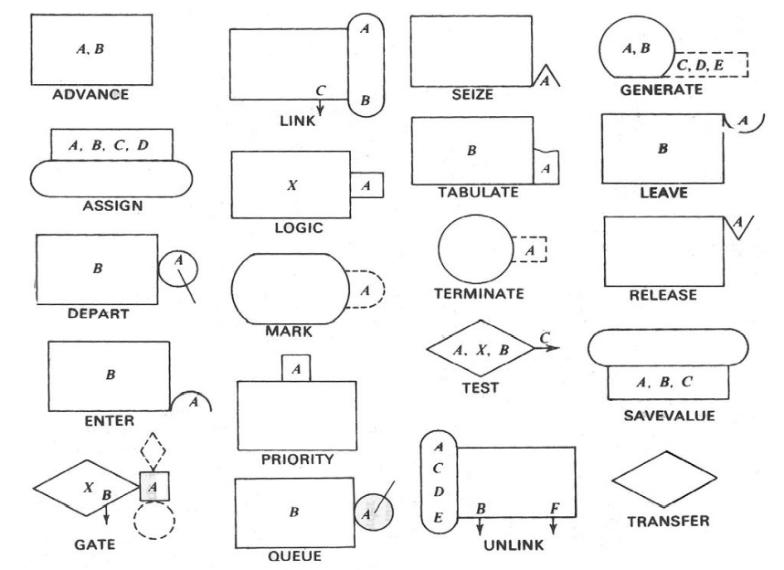
GPSS - Blocks

Slide 12
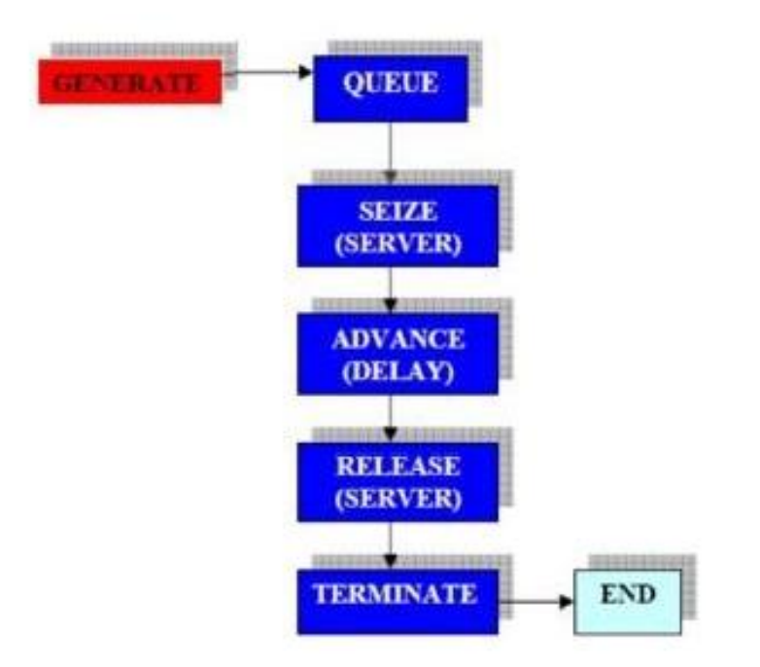
Simulation Languages: GPSS
Basic Structure
A GENERATE Block generates a stream of transactions (customers) with a specific set of behavior. No transaction may again enter this block. Behavior could be deterministic, stochastic, functional, etc. A Transaction leaving a GENERATE Block descends into the next available Block it finds. The entering Block shouldn’t deny entries to transactions. Otherwise, system backups may result.
A QUEUE Block never refuses any transaction. If a transaction cannot enter into the next Block, it stays at the current Block. Therefore, a QUEUE simulates an infinitely long buffer.

Slide 13
Simulation Languages: GPSS
Basic Structure
A transaction attempts to SEIZE a facility (server, router, CPU) for service. If it succeeds, it would leave the current Block and start using the facility. If not, it stays where it is until the next time. As long as a facility is occupied, it cannot allow another transaction to SEIZE it.
An ADVANCE Block captures the transaction and imposes a delay on it wherever it is. The delay could be deterministic, probabilistic, etc.
A RELEASE Block forces a transaction to release its facility. For every successful SEIZE, there must be a RELEASE.
A TERMINATE Block kills the entering transaction here

Slide 14
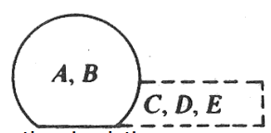
GPSS - Blocks
Generate
A GENERATE Block creates Transactions for future entry into the simulation.
GENERATE A,B,C,D,E
A - Mean inter generation time. Optional.
B - Inter generation time half-range or Function Modifier. Optional.
C - Start delay time. Time increment for the first Transaction. Optional.
D - Creation limit. The default is no limit. Optional.
E - Priority level. Optional. Zero is the default.
GENERATE 0.1
This is the simplest way to use the GENERATE Block. This Block causes a priority zero Transaction to enter the simulation every tenth of a time unit.

Slide 15
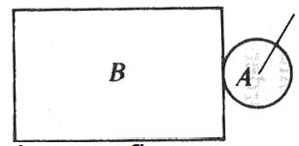
GPSS - Blocks
Queue
A QUEUE Block updates Queue Entity statistics to reflect an increase in content.
QUEUE A,B
A - Queue Entity name or number. Required.
B - Number of units by which to increase the content of the Queue Entity. Default value is 1. Optional.
QUEUE WaitingLine
In this example the content of the Queue Entity named WaitingLine is increased by one and the associated statistics accumulators are updated.

Slide 16
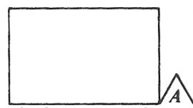
GPSS - Blocks
SEIZE
When the Active Transaction attempts to enter a SEIZE Block, it waits for or acquires ownership of a Facility Entity.
SEIZE A
A - Facility name or number. Required.
SEIZE teller1
In this example, when a Transaction attempts to enter the SEIZE Block, the state of the Facility named Teller1 is tested. If it is idle, ownership is given to the Active Transaction, which is allowed to enter the SEIZE Block and proceed to the Next Sequential Block (NSB). If the Facility is busy (owned), the Active Transaction comes to rest on the Delay Chain of the Facility.

Slide 17
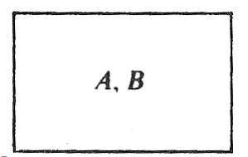
GPSS - Blocks
Advance
An ADVANCE Block delays the progress of a Transaction for a specified amount of simulated time.
ADVANCE A,B
A - The mean time increment. Required.
B - The time half-range or, if a function, the function modifier. Optional.
ADVANCE 101.6, 50.3
This example creates a Block which chooses a random number between 51.3 and 151.9, inclusively (i.e. A-B ,A+B), and delays the progress of a Transaction for a specified amount of simulated time.

Slide 18
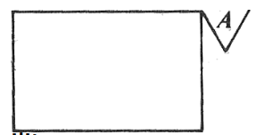
GPSS - Blocks
Release
A RELEASE Block releases ownership of a Facility, or removes a preempted Transaction from contention for a Facility.
RELEASE A
A - Facility number. Required.
RELEASE Teller1
In this example, when a Transaction which owns the Facility Entity named Teller1 enters the RELEASE Block, it gives up ownership to the Facility.

Slide 19
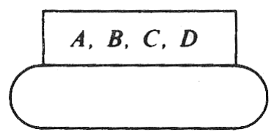
GPSS - Blocks
Assign
ASSIGN Blocks are used to place or modify a value in a Transaction Parameter.
ASSIGN A,B,C,D
A - Parameter number of the Active Transaction. Required.
B - Value. Required.
C - Function number. Optional.
D – Value. Required, if C is not empty
ASSIGN Num, 150.6
This is the simplest way to use the ASSIGN Block. The value 150.6 is assigned to Parameter Num of the entering Transaction. If no such Parameter exists, it is created

Slide 20
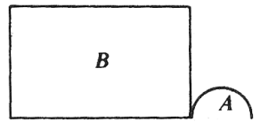
GPSS - Blocks
Enter
When a Transaction attempts to enter an ENTER Block, it either takes or waits for a specified number of storage units.
ENTER A,B
A - Storage Entity name or number. Required.
B - Number of units by which to decrease the available storage capacity. Default value is 1. Optional
ENTER Toolkit, 2
In this example the Active Transaction demands 2 storage units from the storage units available at the Storage Entity named Toolkit. If there are not enough storage units remaining in the Storage Entity, the Transaction comes to rest on the Delay Chain of the Storage Entity.

Slide 21
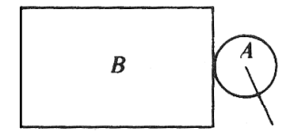
GPSS - Blocks
Depart
A DEPART Block registers statistics which indicate a reduction in the content of a Queue Entity.
DEPART A,B
A - Queue Entity name or number. Required.
B - Number of units by which to decrease content of the Queue Entity. Default value is 1. Optional.
DEPART WaitingLine
In this example the content of the Queue Entity named WaitingLine is reduced by one and the associated statistics accumulators are updated.

Slide 22
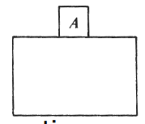
GPSS - Blocks
Priority
A PRIORITY Block sets the priority of the Active Transaction.
PRIORITY A,B
A - New priority value. Required.
B - Buffer option. Places Active Transaction behind priority peers on CEC. Optional.
PRIORITY 10
In this example any entering Transaction is made to have a priority of 10.

Slide 23
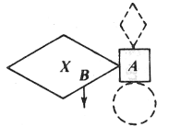
GPSS - Blocks
Gate
A GATE Block alters Transaction flow based on the state of an entity.
GATE O A,B
O - Conditional operator. Condition required of entity to be tested for successful test.
A - Entity name or number to be tested. The entity type is implied by the conditional operator. Required
B - Destination Block number when test is unsuccessful. Optional.
GATE SNF MotorPool
In this example of a "Refuse Mode" GATE Block, the Active Transaction enters the GATE Block if the Storage Entity named MotorPool is not full (i. e. if at least 1 unit of storage is available). If the Storage is full, the Active Transaction is blocked until 1 or more storage units become available.

Slide 24
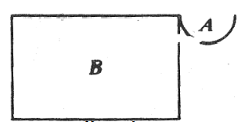
GPSS - Blocks
Leave
A LEAVE Block increases the accessible storage units at a Storage Entity.
LEAVE A,B
A - Storage Entity name or number. Required.
B - Number of storage units. The default is 1. Optional.
LEAVE RepairMen,10
In this example, when a Transaction enters the LEAVE Block, the available storage units at the Storage Entity named RepairMen is increased by 10.

Slide 25
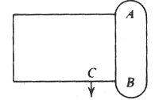
GPSS - Blocks
Link
A LINK Block controls the placement of the Active Transaction on the User Chain of a Userchain Entity.
LINK A,B,C
A - Userchain number. The Userchain Entity which may receive the entering Transaction. Required.
B - Chain ordering. The placement of new Transactions on the Userchain. Required.
C - Next Block location. The destination Block for Transactions which find the Link Indicator of the Userchain in the off state (reset). Optional.
LINK OnHold,FIFO
In this example, the Active Transaction is placed at the end of the User Chain Entity named OnHold. It is removed from all chains except Transaction Groups and Interrupt Chains. In other words, preemptions are not cleared. The Transaction remains on the User Chain until some other Transaction enters an UNLINK Block and specifically removes it. In the present example, the Transaction is placed at the end of the User Chain named OnHold

Slide 26
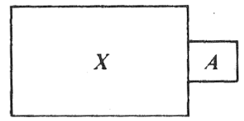
GPSS - Blocks
Logic
A LOGIC Block changes the state of a Logicswitch entity.
LOGIC O A
O - Logic operator. Required.
A - Logicswitch Entity number. Required.
LOGIC S PowerSwitch
In this example, the Logicswitch Entity named PowerSwitch is left in the true or "set" state.

Slide 27
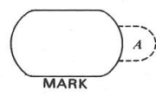
GPSS - Blocks
Mark
A MARK Block places an absolute clock time stamp into the Active Transaction or into its Parameter.
MARK A
A - Parameter number. Parameter to receive value of system clock. Optional.
MARK Beginning
In this example, when a Transaction enters the MARK Block, its Transaction Parameter named Beginning is given a value equal to the value of the absolute system clock, AC1.

Slide 28
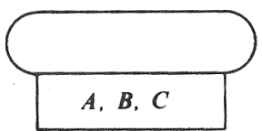
GPSS - Blocks
SAVEVALUE
A SAVEVALUE Block changes the value of a Savevalue Entity.
SAVEVALUE A,B
A - Savevalue Entity number. Required. May be followed by + or - to indicate addition or subtraction to existing value. Required.
B - The value to be stored, added, or subtracted. Required.
SAVEVALUE Account,99.95
In this example, the Savevalue Entity named Account takes on the value 99.95. SAVEVALUE The_Bard,"A rose by any other name ..."
In this example, the Savevalue Entity named The_Bard is assigned a string. If the Savevalue Entity does not exist, it is created.

Slide 29
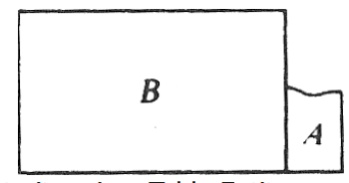
GPSS - Blocks
TABULATE
A TABULATE Block triggers the collection of a data item in a Table Entity.
TABULATE A,B
A - Table Entity name or number. Required.
B - Weighting factor. Optional.
TABULATE Sales
When a Transaction enters this TABULATE Block, the Table Entity named Sales is found. Sales must have been defined in a TABLE Command. Then the statistics associated with the table are updated with no weighting.

Slide 30
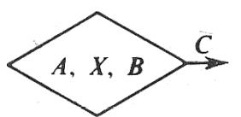
GPSS - Blocks
TEST
A TEST Block compares values, normally SNAs, and controls the destination of the Active Transaction based on the result of the comparison.
TEST O A,B,C
O - Relational operator. Relationship of Operand A to Operand B for a successful test. Required.
B - Reference value. Required.
C - Destination Block number. Optional.
TEST G C1, 70000
In this example of a "Refuse Mode" TEST Block, the Active Transaction enters the TEST Block if the relative system clock value is greater than 70000. Otherwise, the Transaction is blocked until the test is true.

Slide 31
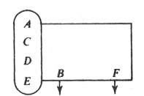
GPSS - Blocks
UNLINK
An UNLINK Block removes Transactions from the User Chain of a Userchain Entity.
UNLINK O A,B,C,D,E,F
O - Relational operator. Relationship of D to E for removal to occur. These choices are explained below. Optional.
A - User Chain number. User Chain from which one or more Transactions will be removed. Required.
B - Block number. The destination Block for removed Transactions. Required.
C - Removal limit. The maximum number of Transactions to be removed. If not specified, ALL is used. Optional
D - Test value. The member Transaction Parameter name or number to be tested, a Boolean variable to be tested, or BACK to remove from the tail of the chain. Optional.
E - Reference value. The value against which the D Operand is compared. Optional.
F - Block number. The alternate destination for the entering Transaction. Optional.
UNLINK OnHold,Reentry,1
This is the simplest way to use the UNLINK Block. The first Transaction at the head of the Userchain Entity named OnHold, if any, is taken off the chain and is directed to the Block labeled Reentry. It is put on the CEC behind Transactions of the same priority. The Transaction entering the UNLINK Block proceeds to the Next Sequential Block.

Slide 32
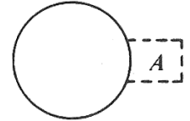
GPSS - Blocks
Terminate
A TERMINATE Block removes the Active Transaction from the simulation and optionally reduces the Termination Count.
TERMINATE A
A - Termination Count decrement. Default is 0. Optional.
TERMINATE 1
In this example, when a Transaction enters the TERMINATE Block it is removed from the simulation. Also, the Termination Count of the simulation, which is set by a START Command is decremented by 1.

Slide 33
GPSS – Basic Commands
CLEAR : reset statistics and remove transactions
CONTINUE : resume the simulation
EXIT : end the GPSS world session
HALT : stop the simulation and delete all queued commands
INCLUDE : read and translate a secondary model file
INTEGRATE : automatically integrate a time differential in a use variable
REPORT : set the name of the report file or request an immediate report
RESET : reset the statistics of the simulation
SHOW : evaluate and display expression
START : set the termination count and begin a simulation
STEP : attempt a limited number of block entities
STOP : set a stop condition based on block entry attempts
STORAGE : define a storage entity
TABLE : define a table entity
VARIABLE : define a variable entity

Slide 34
GPSS – Basic Commands
CLEAR - A CLEAR Command returns the simulation to the unused state. CLEAR A
A - ON or OFF. If the A Operand is omitted, ON is assumed. Optional.
FUNCTION
A FUNCTION Command defines the rules for a table lookup. NAME FUNCTION A,B
NAME - Entity Label this entity. Required.
A - Function argument. Required.
B - Function type (one letter) followed immediately by the number of data pairs in the Function Follower Statements. Required.

Slide 35
GPSS – Basic Commands
RESET - A RESET Command marks the beginning of a measurement period. RESET
START - A START Command begins a simulation. START A,B,C,D
A - Termination count. Required.
B - Printout operand. NP for “no printout”. Default is to print a standard report. Optional.
C - Not used. Kept for compatibility with older dialects of GPSS
D - Chain printout. 1 to include the CEC and FEC in the standard report. Optional.

Slide 36
GPSS – Basic Commands
STORAGE - A STORAGE Command defines a Storage Entity. NAME STORAGE A
NAME - Entity Label for this entity. Required.
A - Total storage capacity. Required.
TABLE - A TABLE Command initializes a frequency distribution table. NAME TABLE A,B,C,D
NAME - Entity Label for this entity. Required.
A - Table argument. The data item whose frequency distribution is to be tabulated. Optional.
B - Upper limit of first frequency class. The maximum argument which causes the first frequency class to be updated. Required.
C - Size of frequency classes. The difference between the upper limit and lower limit of each frequency class. Required.
D - Number of frequency classes. Required.

Slide 37
GPSS - Entities
Transaction entities:
GENERATE, SPLIT, TRANSFER, TERMINATE ..
Facilities entities:
SEIZE, RELEASE ..
Queue entities:
QUEUE, DEPART ….
Storage entities:
ENTER, LEAVE,STORAGE…

Slide 38
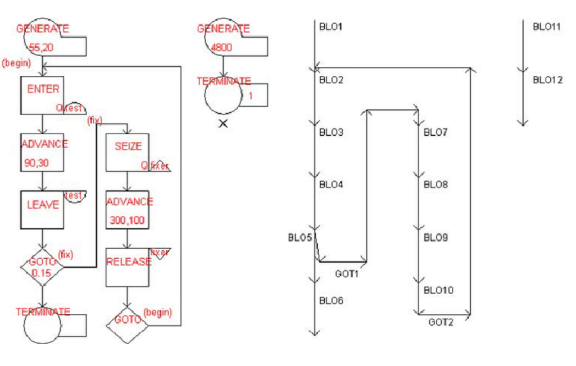

Slide 39
Case Studies of different types of Simulation Models
A barber shop simulator
We are modeling a barber shop with the following qualities:
The shop contains one barber and one barber’s chair, open for eight hours in a day.
Customers arrive on average every 18 minutes, with the arrival time varying between 12 and 24 minutes.
If the barber is busy, the customer will wait in a queue.
Once the barber is free, the next customer will have a haircut.
Each haircut takes between 12 and 18 minutes, with the average being 15 minutes.
Once the haircut is done, the customer will leave the shop.

Slide 40
Case Studies of different types of Simulation Models
A barber shop simulator
We want to answer these questions:
How utilised is the barber through the day?
How long does the queue get?
On average, how long does a customer have to wait.

Slide 41
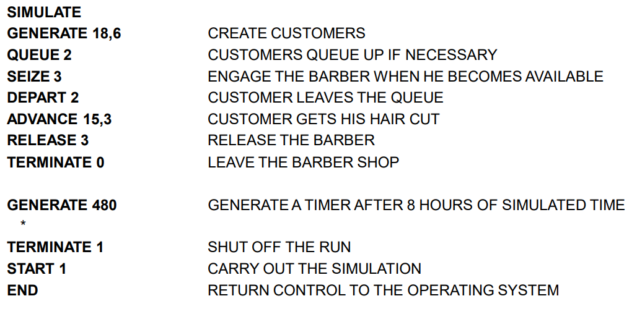
Case Studies of different types of Simulation Models
A barber shop simulator

Slide 42
Case Studies of different types of Simulation Models
GENERATE 18,6 means generate a transaction - a barber shop customer - every 18 minutes ± 6 minutes.
QUEUE 2 defines a queue with ID 2, denoting the queue where customers will wait.
SEIZE 3 defines a facility with ID 3. The facility is the barber and this line means if the barber is free, the next customer occupies the barber until released.
DEPART 2 says that the customer leaves the queue when occupying the barber.
ADVANCE 15,3 means that transactions in this state only move on after 15 minutes ± 3 minutes - modeling the time taken for a haircut. After that
RELEASE 3 shows that the customer no longer occupies the barber and
TERMINATE 0 ends the transaction, showing that the customer has left the shop

Slide 43
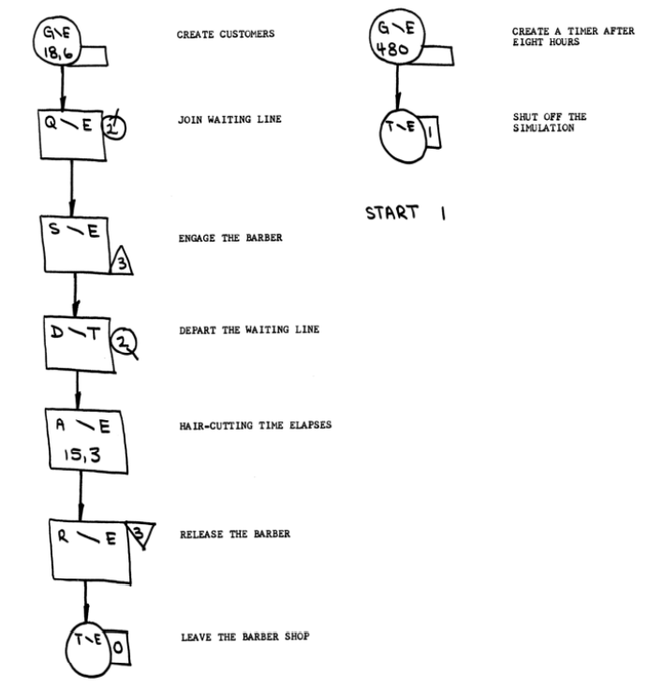
Case Studies of different types of Simulation Models

Slide 44
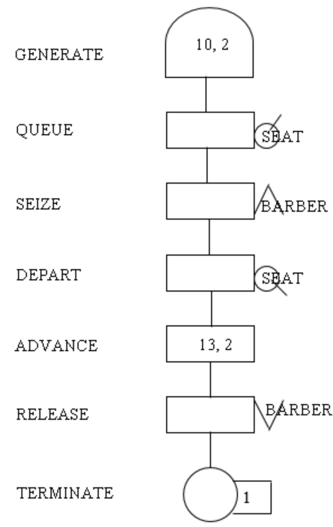
Case Studies of different types of Simulation Models
Create a GPSS model and program to simulate a barber shop for a day (9 am to 4pm), where a customer enters the shop every 10 +- 2 minutes and a barber takes 13 +- 2 for a haircut.
GENERATE 10,2
QUEUE SEAT
SEIZE BARBER
DEPART SEAT
ADVANCE 13,2
RELEASE BARBER
TERMINATE
TIMER GENERATE 420
TERMINATE 1

Slide 45
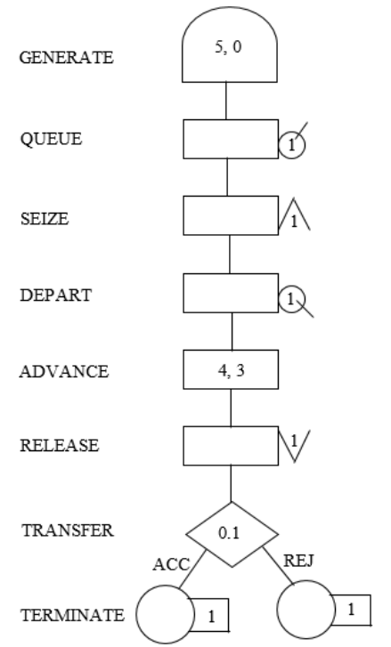
Case Studies of different types of Simulation Models
Consider that a machine tool in a manufacturing shop is turning out parts at the rate of one every 5 minutes. As they are finished, the parts go to an inspector, who takes 4±3 minutes to examine each one and rejects 10% of the parts. Now, develop a block diagram and write the code for simulating the above problem using GPSS, and also explain the function of each block used in the block diagram in detail. [10 MARKS]
GENERATE 5,0
QUEUE 1
SEIZE 1
DEPART 1
ADVANCE 4,3
RELEASE 1
TRANSFER 0.1 ACC REJ
ACC TERMINATE 1
REJ TERMINATE 1

Slide 46
Case Studies of different types of Simulation Models
A machine tool in a manufacturing shop is turning out parts at the rate of every 10 minutes. When they are finished, the parts are sent to an inspector, who takes 10±5 minutes to examine each one and rejects 20% of the parts. Draw and explain a block diagram for it and write a GPSS program to simulate using the concept of FACILITY.
GENERATE 10,0
QUEUE 1
SEIZE 1
DEPART 1
ADVANCE 10,5
RELEASE 1
TRANSFER 0.2 ACC REJ
ACC TERMINATE 1
REJ TERMINATE 1

Slide 47
Case Studies of different types of Simulation Models
More Examples
GPSS Tutorial
GPSS Software

Slide 48
Questions
Explain any four program control statements that are used in GPSS.
Draw and describe the different types of GPSS blocks.
What do you mean by simulation tool?
Explain GPSS with example
Create a GPSS model and program to simulate a barber shop for a day (9 am to 4pm), where a customer enters the shop every 10 +- 2 minutes and a barber takes 13 +- 2 for a haircut

